Slide 1

College of Science, Mathematics and Technology
SmartCourse: Course Selection System with AI Suggestion Module
Team members:
Yixuan Mi
Yiduo Yu
Yiyi Zhao
Notes:
Hello everyone. Today, we will introduce our final project, which is SmartCourse.

Slide 2
Introduction
Agenda
Advantages
System Structure
Code Demonstration

Slide 3
College of Science, Mathematics and Technology
Introduction
SmartCourse is an intelligent course selection system built with Python.
It provides real-time enrollment, email alerts, and AI-based course advising.
Students receive personalized recommendations based on their academic history and major plan. The system supports both command-line and web UI (Gradio), ensuring flexibility for different users.

Slide 4
College of Science, Mathematics and Technology
Advantages
AI-Powered Advisor: Local LLM (DeepSeek-r1:1.5b) gives personalized suggestions.
Email Notifications: Student/instructors get real-time updates.
Dual UI: CLI for testing, Gradio for daily use.
Lightweight Storage: Pure TXT files, no database.
Privacy Friendly: No external API calls needed.
Modular Design: Easy to update or extend.

Slide 5
System Structure

Slide 6
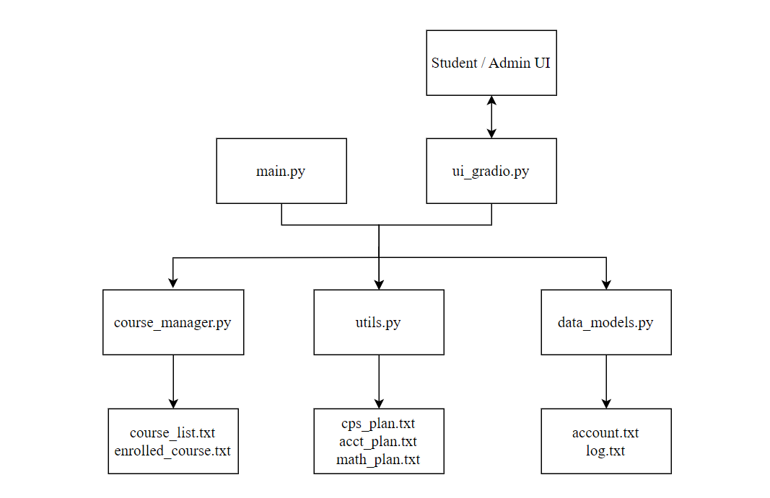
Notes:
Layered architecture: UI layer (CLI & Gradio) routes requests to the CourseManager core; CourseManager manipulates domain models (Student, Instructor) and persists to lightweight TXT files. The AI engine (Ollama-served LLM) and SMTP email service are plug-in side modules, invoked through clean interfaces, so they can be swapped without touching core logic.

Slide 7
Code Demonstration

Slide 8
Thanks!
Team members:
Yixuan Mi
Yiduo Yu
Yiyi Zhao

